Slide 1
the central concept
A cluster of objects treated as a single unit.
Often modeled as a state machine.
aggregate
Only accessed through its Root Entity.
The atomic unit for any transactional
behavior.
Responsible for maintaining any/all business invariants.

Slide 2
the central concept
A cluster of objects treated as a single unit.
Often modeled as a state machine.
Entity
Value object
Entity
aggregate
Only accessed through its Root Entity.
The atomic unit for any transactional
behavior.
Entity
Value object
Value object
Responsible for maintaining any/all business invariants.

Slide 3
An object whose state changes over time, but whose identity remains the same.
Entity

Slide 4

Entity
An object whose state changes over time, but whose identity remains the same.
!
{
id: 1,
name: age: 0
“Joe”,
}

Slide 5

Entity
An object whose state changes over time, but whose identity remains the same.
! "
{
{
id: 1,
id: 1,
name: age: 0
“Joe”,
name: age: 8
“Joe”,
}
}

Slide 6

Entity
An object whose state changes over time, but whose identity remains the same.
! " #
{
{
{
id: 1,
id: 1,
id: 1,
name: age: 0
“Joe”,
name: age: 8
“Joe”,
name: “Joe”, age: 35
}
}
}

Slide 7
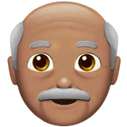
Entity
An object whose state changes over time, but whose identity remains the same.
! " # $
{ {
id: 1, id: 1,
{
{
id: 1,
id: 1,
 | name: | “Joe”, |  | name: | “Joe”, |  | name: | “Joe”, |  | name: | “Joe”,
 | age: | 0 |  | age: | 8 |  | age: | 35 |  | age: | 60
} |  |  | } |  |  | } |  |  | }

Slide 8
Value object
An object whose identity is inseparable
from its value.

Slide 9
Value object
An object whose identity is inseparable
from its value.
#
{
id: 1,
name: age: 35,
“Joe”,
address: <PTR>
}

Slide 10

Value object
An object whose identity is inseparable
from its value.
%
#
{
{
id: 1,
street: “123 Vine St.”,
name: age: 35,
“Joe”,
city: “Memphis”, state: “TN”
address: <PTR>
}
}

Slide 11
Value object
An object whose identity is inseparable
from its value.
%
#
{
{
id: 1,
street: “123 Vine St.”,
name: age: 35,
“Joe”,
city: “Memphis”, state: “TN”
address: <PTR>
}
}

Slide 12

Value object
An object whose identity is inseparable
from its value.
%
#
&
{
{
id: 1,
{
street: “123 Vine St.”,
name: age: 35,
“Joe”,
street: “123 Long Rd.”,
city: “Memphis”, state: “TN”
city: “Memphis”, state: “MI”
address: <PTR>
}
}
}

Slide 13
Value object
An object whose identity is inseparable
from its value.
%
#
&
{
{
id: 1,
{
street: “123 Vine St.”,
name: age: 35,
“Joe”,
street: “123 Long Rd.”,
city: “Memphis”, state: “TN”
city: “Memphis”, state: “MI”
address: <PTR>
}
}
}

Slide 14
Entity
Value object
Entity
aggregate
Entity
Value object
Value object

Slide 15
Protect business invariants inside Aggregate boundaries.
Entity
Value object
Entity
aggregate
Entity
Value object
Value object

Slide 16
Protect business invariants inside Aggregate boundaries.
Entity
Value object
Entity
aggregate
Entity
Value object
Value object
Order
Business Invariant: “Can only place an order if it contains at least one line item.”

Slide 17
Protect business invariants inside Aggregate boundaries.
Entity
Value object
Entity
aggregate
Entity
Value object
Value object
PLACE ORDER
Order
Business Invariant: “Can only place an order if it contains at least one line item.”

Slide 18
Protect business invariants inside Aggregate boundaries.
Entity
Value object
Entity
aggregate
Entity
Value object
Value object
PLACE ORDER
Order
Line item
Business Invariant: “Can only place an order if it contains at least one line item.”

Slide 19
Protect business invariants inside Aggregate boundaries.
Entity
Value object
Entity
aggregate
Entity
Value object
Value object
PLACE ORDER
Order
Line item
Business Invariant: “Can only place an order if it contains at least one line item.”

Slide 20
Entity
Value object
Entity
Design small Aggregates.
aggregate
Entity
Value object
Value object
Example credit: Vaughn Vernon, Implementing Domain-Driven Design

Slide 21
Entity
Value object
Entity
Design small Aggregates.
aggregate
Entity
Value object
Value object
Product
(root)
Backlog item
release
sprint
Large Cluster Aggregate
Example credit: Vaughn Vernon, Implementing Domain-Driven Design

Slide 22


Entity
Value object
Entity
Design small Aggregates.
aggregate
Entity
Value object
Value object
'
Product
(root)
Backlog item
release
sprint
(
Large Cluster Aggregate
Example credit: Vaughn Vernon, Implementing Domain-Driven Design

Slide 23
Entity
Value object
Entity
Design small Aggregates.
aggregate
Entity
Value object
Value object
'
Product
(root)
Backlog item
release
sprint
(
Large Cluster Aggregate
Example credit: Vaughn Vernon, Implementing Domain-Driven Design

Slide 24
Entity
Value object
Entity
Design small Aggregates.
aggregate
Entity
Value object
Value object
'
Product
(root)
Product
(root)
product id
Backlog item
release
sprint
backlog item
(root)
RELEASE
(root)
SPRINT
(root)
(
Large Cluster Aggregate
Multiple Aggregates
Example credit: Vaughn Vernon, Implementing Domain-Driven Design

Slide 25
Entity
Value object
Entity
Design small Aggregates.
aggregate
Entity
Value object
Value object
'
'
Product
(root)
Product
(root)
product id
Backlog item
release
sprint
backlog item
(root)
RELEASE
(root)
SPRINT
(root)
(
(
Large Cluster Aggregate
Multiple Aggregates
Example credit: Vaughn Vernon, Implementing Domain-Driven Design

Slide 26
Entity
Value object
Entity
Design small Aggregates.
aggregate
Entity
Value object
Value object
'
'
Product
(root)
Product
(root)
product id
Backlog item
release
sprint
backlog item
(root)
RELEASE
(root)
SPRINT
(root)
(
(
Large Cluster Aggregate
Multiple Aggregates
Example credit: Vaughn Vernon, Implementing Domain-Driven Design

Slide 27
Reference other Aggregates
by Identity only.
Entity
Value object
Entity
aggregate
Entity
Value object
Value object

Slide 28
Reference other Aggregates
by Identity only.
Entity
Value object
Entity
aggregate
Entity
Value object
Value object
order
(root)
line item
Product
(root)
Composition

Slide 29
Reference other Aggregates
by Identity only.
Entity
Value object
Entity
aggregate
Entity
Value object
Value object
order
(root)
line item
Product
(root)
Composition

Slide 30
Reference other Aggregates
by Identity only.
Entity
Value object
Entity
aggregate
Entity
Value object
Value object
order
(root)
order
(root)
Product
(root)
line item
Product
(root)
line item
product id
Composition
Reference

Slide 31
Reference other Aggregates
by Identity only.
Entity
Value object
Entity
aggregate
Entity
Value object
Value object
order
(root)
order
(root)
Product
(root)
line item
Product
(root)
line item
product id
Composition
Reference

Slide 32
Update other Aggregates using Eventual Consistency.
Entity
Value object
Entity
aggregate
Entity
Value object
Value object

Slide 33
Update other Aggregates using Eventual Consistency.
Entity
Value object
Entity
aggregate
Entity
Value object
Value object
Shipping customer
{
Customer
{
id: 1, first_name: last_name:
id: 1,
“Joe”,
name: “Joe User”
“User”
}
}

Slide 34

Update other Aggregates using Eventual Consistency.
Entity
Value object
Entity
aggregate
Entity
Value object
Value object
Shipping customer
{
Customer
{
id: 1, first_name: last_name:
_{“Joseph”,} domain event
“User”
id: 1,
name: “Joe User”
}
}
Customer Updated!

Slide 35
Update other Aggregates using Eventual Consistency.
Entity
Value object
Entity
aggregate
Entity
Value object
Value object
Shipping customer
{
Customer
{
id: 1, first_name: last_name:
id: 1,
“Joseph”,
domain event
name: “Joseph User”
“User”
}
}
Customer Updated!

Slide 36


A record of a business-significant occurrence
within a Bounded Context.
domain event
aggregate
aggregate
')
πελάτης
aggregate
_{')} ग्राहक

Slide 37

A record of a business-significant occurrence
within a Bounded Context.
domain event
aggregate
aggregate
')
πελάτης
aggregate
_{')} ग्राहक

Slide 38
A record of a business-significant occurrence
within a Bounded Context.
domain event
aggregate
aggregate
OrderPlacedEvent
ItemAddedToOrderEvent
')
OrderCanceledEvent
πελάτης
aggregate
OrderPaidEvent
')
OrderFulfilledEvent
ग्राहक
OrderDeliveredEvent

Slide 39
domain services
Stateless operations that don’t belong on an Entity.

Slide 40
domain services
Stateless operations that don’t belong on an Entity.
domain service
Apply Coupon to Order

Slide 41
domain services
Stateless operations that don’t belong on an Entity.
order
domain service
coupon
Apply Coupon to Order

Slide 42
domain services
Stateless operations that don’t belong on an Entity.
order
domain service
order
(with coupon applied)
coupon
Apply Coupon to Order

Slide 43
application services
The first client to your domain model.

Slide 44
application services
The first client to your domain model.
application Service

Slide 45
application services
The first client to your domain model.
application Service
{
id: 1
}
place order

Slide 46
application services
The first client to your domain model.
application Service
{
id: 1
}
place order
find by id
Repository

Slide 47
application services
The first client to your domain model.
application Service
{
id: 1
}
place order
find by id
Repository
order

Slide 48
application services
The first client to your domain model.
application Service
{
id: 1
}
place order
place order
find by id
Repository
order

Slide 49
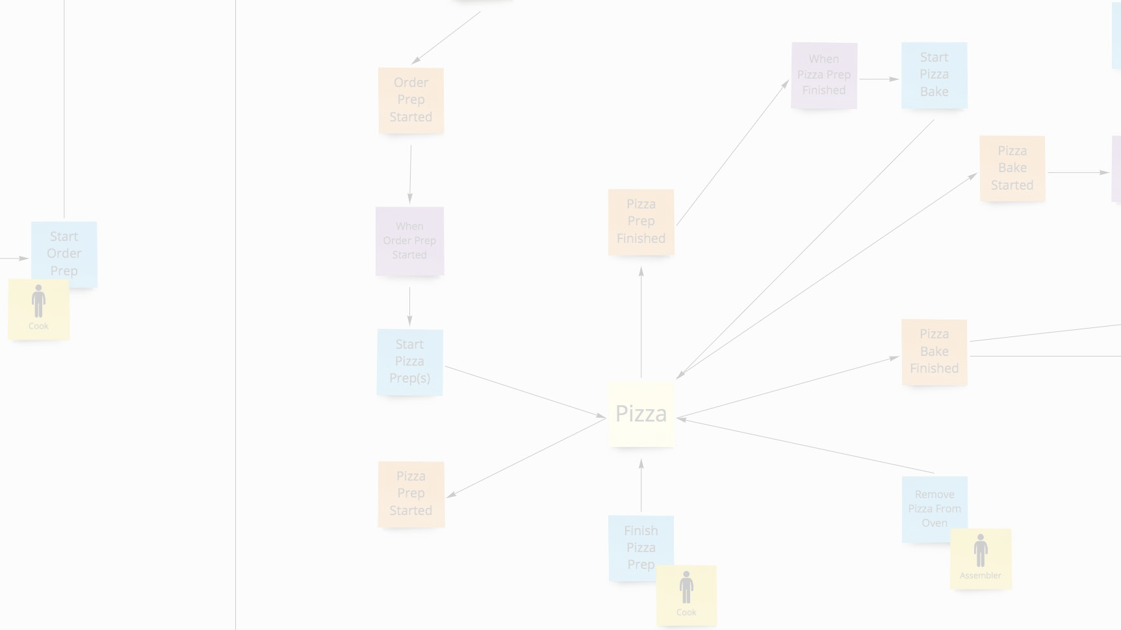
thank you!
Domain-Driven Design and Event-Driven Microservices
Matt Stine (@mstine) http://mattstine.com matt.stine@gmail.com

Slide 50
event storming
Domain-Driven Design and Event-Driven Microservices
Matt Stine (@mstine) http://mattstine.com matt.stine@gmail.com

Slide 51
An easy to learn and low tech collaboration technique that can help you jumpstart Domain-Driven Design.

Slide 52




Who should participate?
!
#
"ssensiBu !ignerDes
Owner
Data
Developer
Scientist
$ %
&
Product
Operator
Tester
Manager

Slide 53
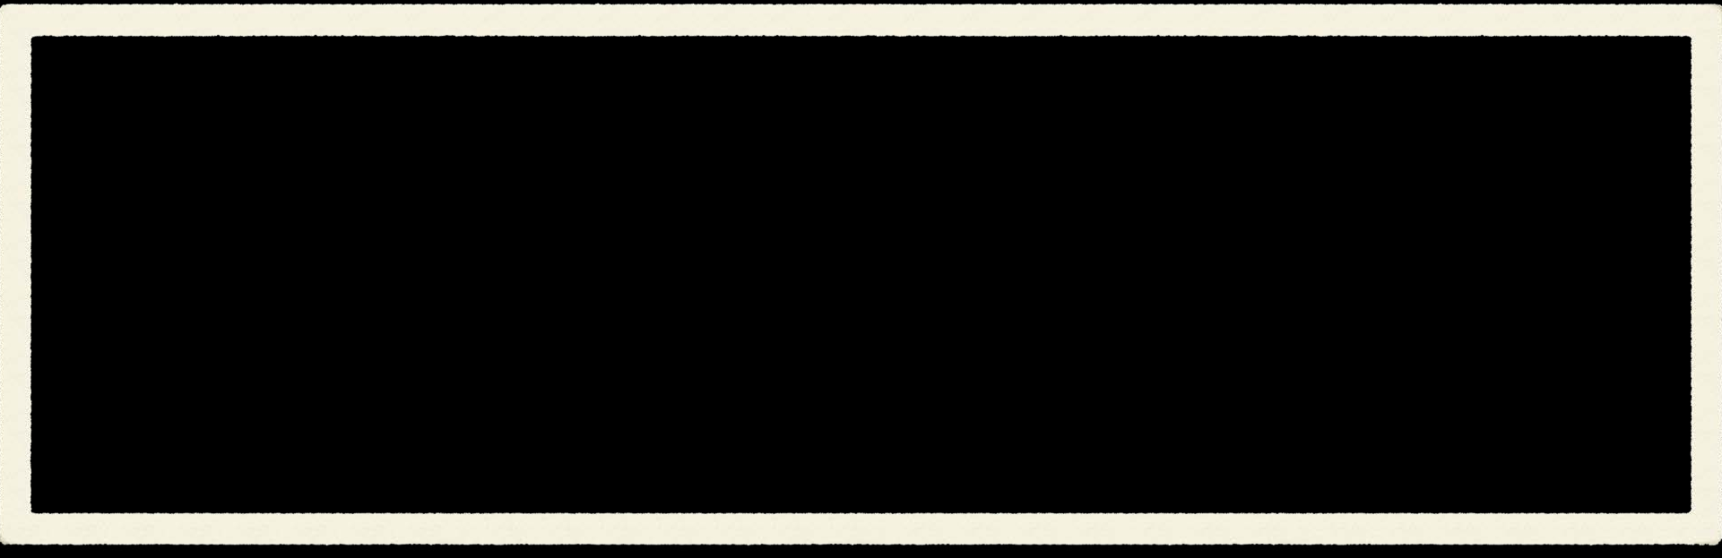
what do you need?
A Large Modeling Surface

Slide 54

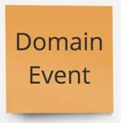
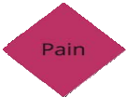
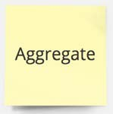


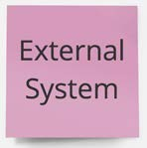



what do you need?
A Large Modeling Surface
Visible Legend

Slide 55

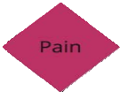
what do you need?
A Large Modeling Surface
Colored Stickies
Visible Legend

Slide 56
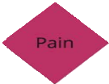
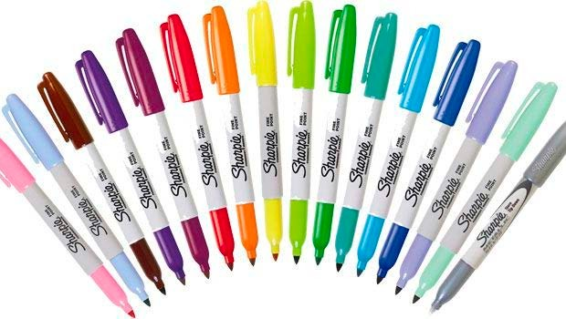
what do you need?
A Large Modeling Surface
Colored Stickies
Markers
Visible Legend

Slide 57
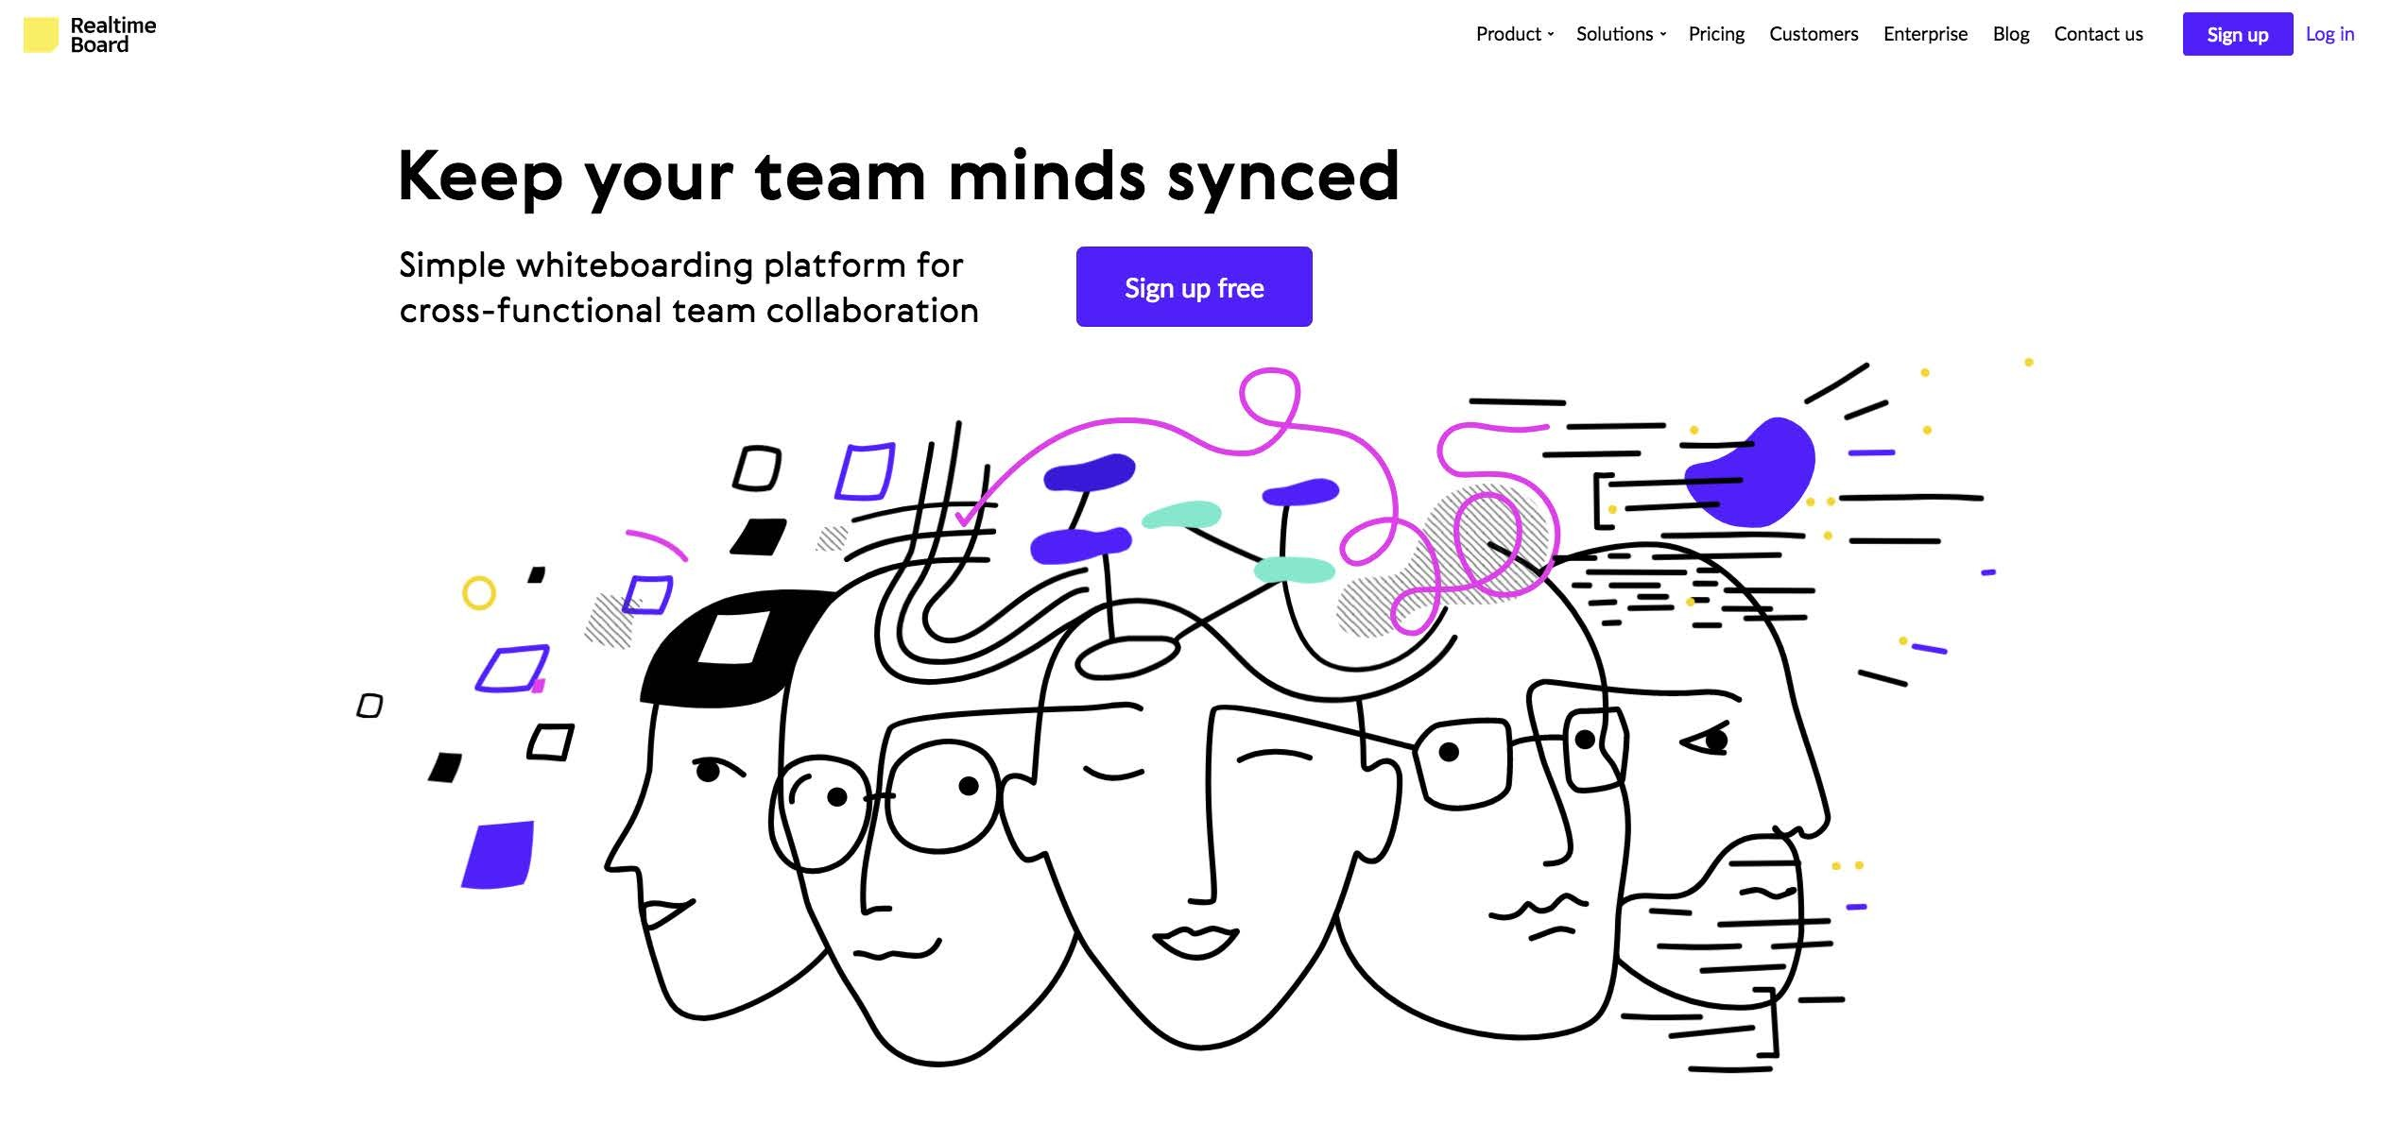

https://realtimeboard.com/

Slide 58
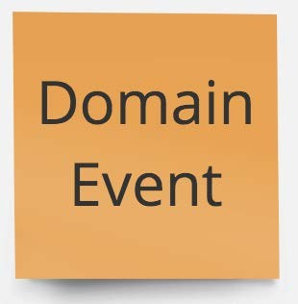
A published record of some business- significant event that has occurred.

Slide 59
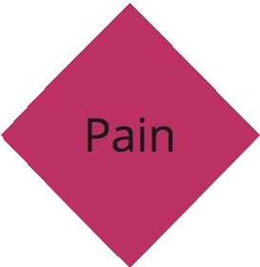
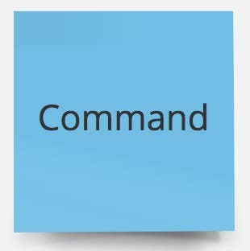
unstructured exploration

Slide 60
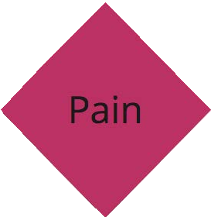
organize into the timeline

Slide 61
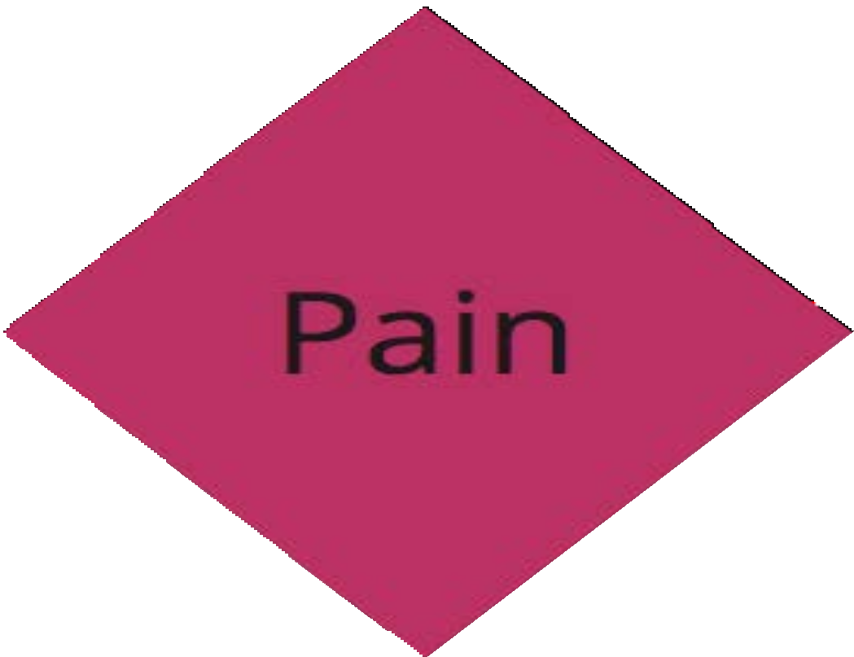

A painful spot, bottleneck, or hotspot that occurs during the event timeline.

Slide 62
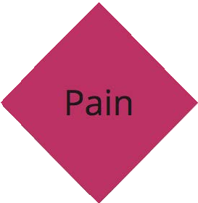
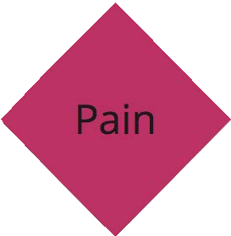
everybody hurts

Slide 63
A request on the behalf on an actor to initiate
some business process.

Slide 64
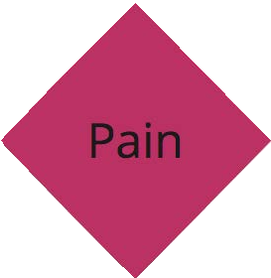
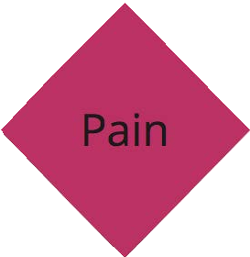
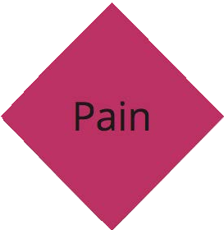
work backwards in the story

Slide 65
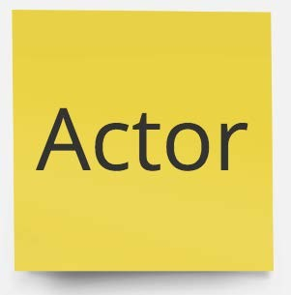
A user persona within the domain that requests a command to be executed.

Slide 66
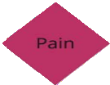
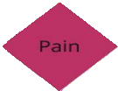
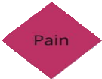
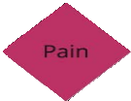
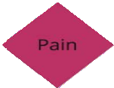


WHODUNIT?

Slide 67
A statement that when one or more specific Domain Events occur, something else should happen.

Slide 68
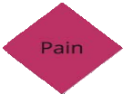
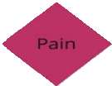
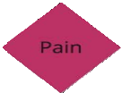
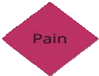
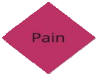
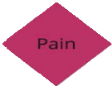

make it so

Slide 69
A view of the data captured within the domain that an Actor uses to gather information necessary to make a decision.

Slide 70
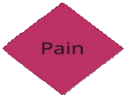
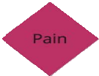
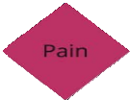
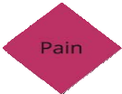
decisions, decisions…

Slide 71
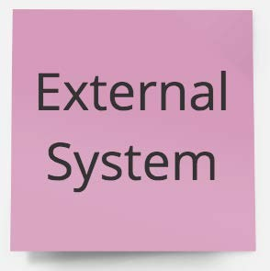
A system that exists outside of the modeled domain that collaborates with the domain
being modeled.

Slide 72
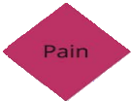
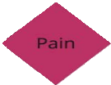
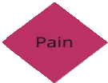
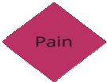
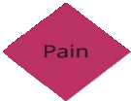
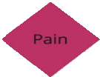
hello from the other siDE

Slide 73
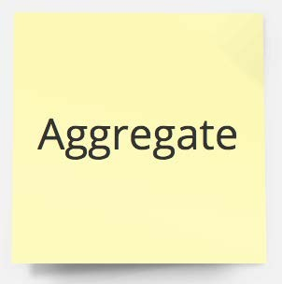
A transactionally-consistent group of entities that maintains business invariants. Commands are executed on Aggregates, and they publish Domain Events.

Slide 74
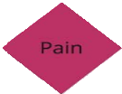
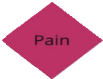
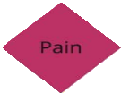
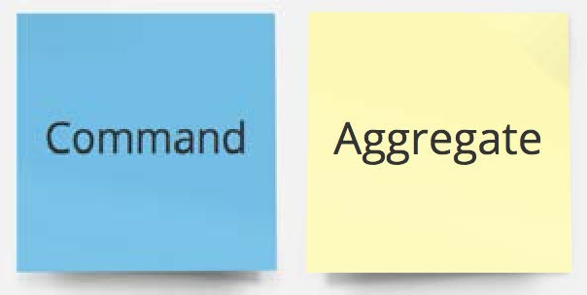
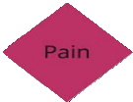
return of the nouns

Slide 75

go hunting for bounded contexts

Slide 76
thank you!
Domain-Driven Design and Event-Driven Microservices
Matt Stine (@mstine) http://mattstine.com matt.stine@gmail.com

Slide 77
the pizza shop domain
Domain-Driven Design and Event-Driven Microservices
Matt Stine (@mstine) http://mattstine.com matt.stine@gmail.com

Slide 78

This is MY pizza shop.
There are others like it, but this one is MINE.

Slide 79

Online Ordering
■
A customer can pick the size of their pizza, and they can choose the combination of toppings they want.
A customer can place an order, but only if it first contains at least one pizza.
■
A customer can choose to have their pizza delivered, or they can pick it up at the store.
■
Our pizza shop accepts payment online via credit card.

Slide 80

In the Store
Cooks prepare pizzas.
Cooks bake pizzas.
Assemblers will remove pizzas from the oven, cut and box the pizzas, and assemble the orders into stacks.
Cashiers will handle pickup orders, and can accept payment at the store.
Drivers are issued “road tills” which must be reconciled at the end of their shift.
■
Drivers can select orders to add to their upcoming routes.

Slide 81

on the road
■
The driver follows the route.
The driver delivers pizzas.
■
The driver can also accept payment and issue change from their road till.

Slide 82

notification system for customers
My Order was Received by the Store
The Store is Prepping My Order
The Store is Baking My Order
■
The Store is Assembling My Order
My Order is Ready for Pickup
My Order is On the Way
■
My Order has been Delivered/Picked Up

Slide 83
thank you!
Domain-Driven Design and Event-Driven Microservices
Matt Stine (@mstine) http://mattstine.com matt.stine@gmail.com

Slide 84
event storm→ddd/stories/tdd
Domain-Driven Design and Event-Driven Microservices
Matt Stine (@mstine) http://mattstine.com matt.stine@gmail.com

Slide 85
agenda
■
From Event Storm to DDD Concepts
From Event Storm to User Stories
■
From Event Storm to TDD Tests
From Event Storm to Code

Slide 86

from event storm to ddd

Slide 87

from event storm to ddd
aggregate

Slide 88

from event storm to ddd
aggregate
domain event

Slide 89
from event storm to ddd
aggregate
domain event
bounded context

Slide 90
user stories

Slide 91
user stories
As a ROLE

Slide 92
user stories
As a ROLE
I want to ACTION

Slide 93
user stories
As a ROLE
I want to ACTION So that I can GOAL

Slide 94

user stories
As a ROLE
I want to ACTION So that I can GOAL

Slide 95
user stories
As a ROLE
I want to ACTION So that I can GOAL

Slide 96
user stories
As a ROLE
I want to ACTION So that I can GOAL

Slide 97

user stories
As a ROLE
I want to ACTION So that I can GOAL

Slide 98

user stories
As a ROLE
I want to ACTION So that I can GOAL

Slide 99
What about TESTS?

